Slide 1

Stock Market Price Prediction
Team 29
Jojo Dong
Ayush Kumar
Yolanda Li
Colette Ma
Syed Irtiza Mehdi

Slide 2

AGENDA
Business Problem
Data Preparation
Modelling
Evaluation
Deployment
Q&A

Slide 3

Business Problem
Objective
Benefits
To use Long Short-Term Memory (LSTM) neural networks to forecast stock prices or trends more accurately by learning sequential patterns in historical data
Algorithmic Trading
Stakeholders
Investors and Traders: Benefit from more reliable predictions to maximize returns
Financial Institutions: Use predictive models for risk assessment and trading strategies
Portfolio Optimization
Risk Management
Market Sentiment Analysis

Slide 4
Data Preparation
Historical stock data fetched from Yahoo Finance API using the yfinance library
Standardized column names to a uniform format: date, adj close, close, high, low, open, volume
Converted historical data into overlapping sequences with a fixed time step (e.g., 30 days)
Final format of raw data converted to NumPy arrays, ensuring compatibility with LSTM

Slide 5

Model Architecture
Bidirectional LSTM
Hyperparameter Tuning
Variant of the standard LSTM model
Extends processing the sequence in both forward and backward directions simultaneously
Allows the model to consider context from both past and future time steps
Performed hyperparameter tuning with batch sizes (32, 64, 128) and epochs (10–40) to balance training speed, stability, and overfitting
Experimented with up to 2 LSTM layers and 128 units per layer to capture complex patterns

Slide 6
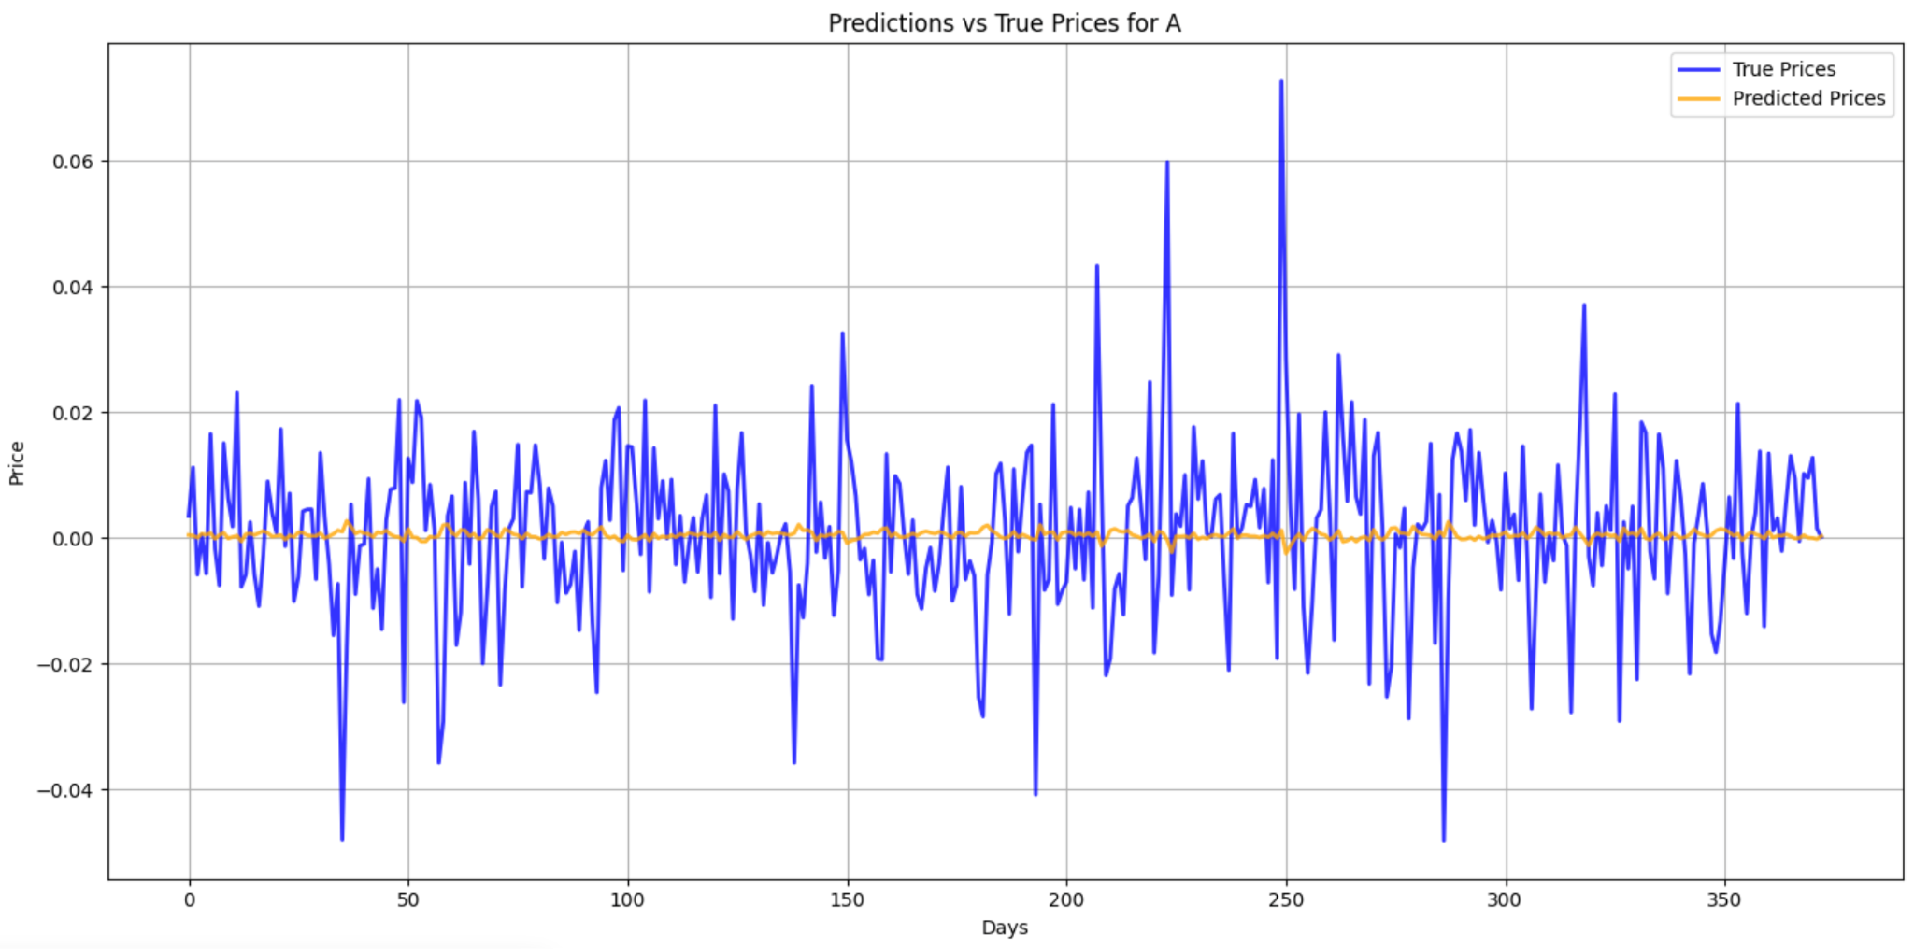
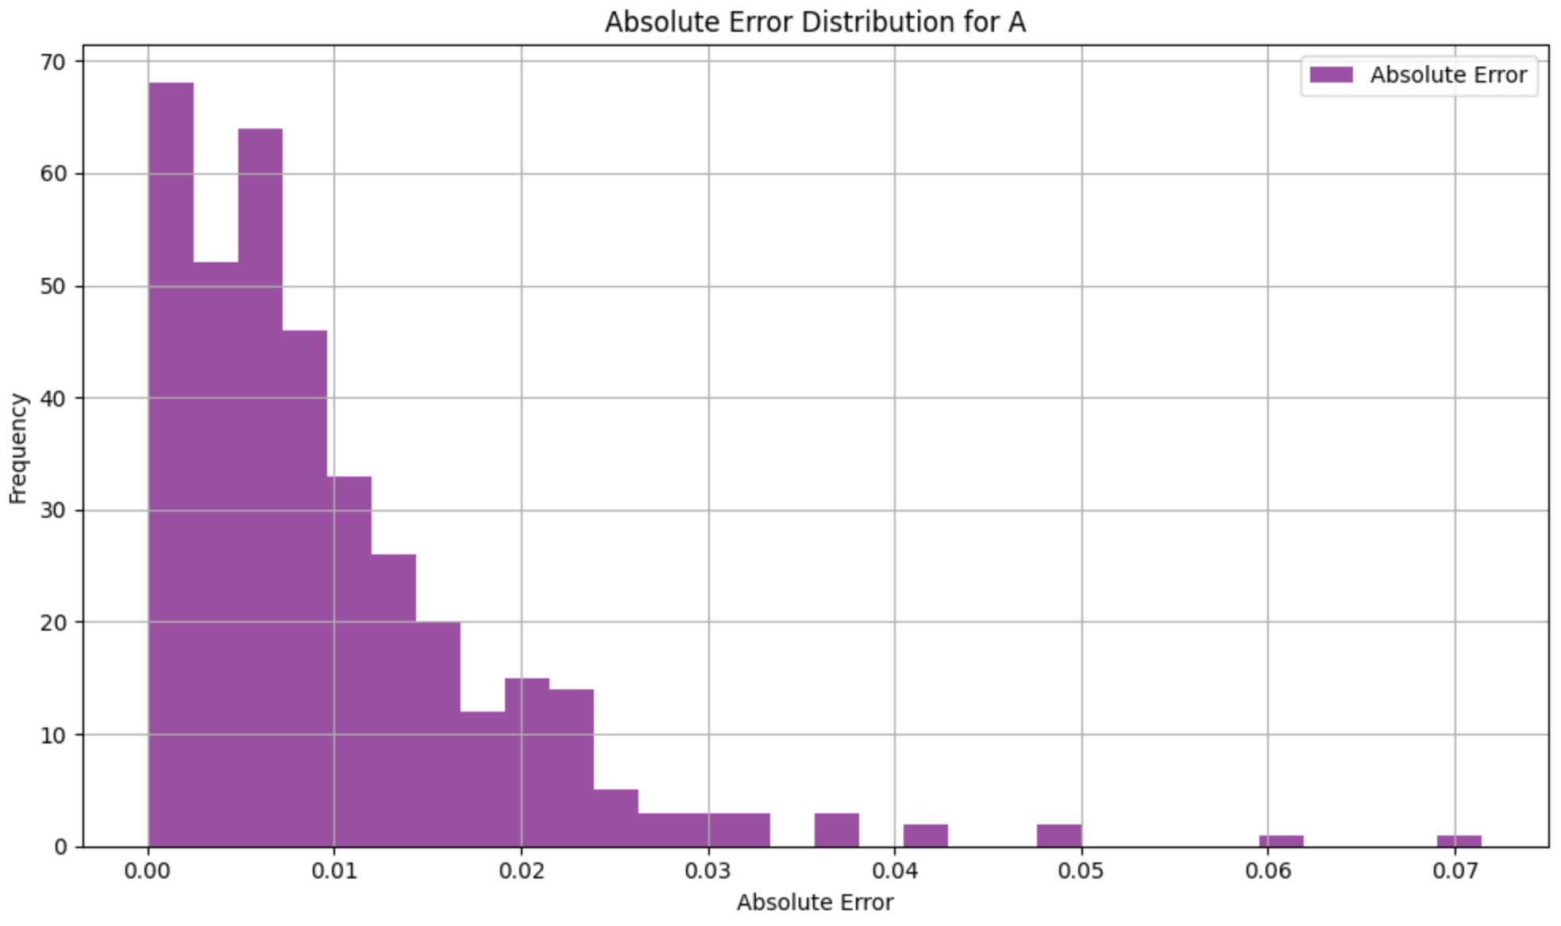
Evaluation
Performance Metrics
Mean Squared Error (MSE): 0.0002
Root Mean Squared Error (MSE): 0.0136
Mean Absolute Error (MAE): 0.0100
Mean Absolute Scaled Error (MASE): 0.7183

Slide 7

Deployment
Strategy
Challenges
Cloud Integration enables real time predictions and decision making
Alternatively can be deployed with existing financial dashboards
Risk of inefficiency during high trading volumes or large data inflows
Model may fail to generalize in dynamic markets

Slide 8
Thank you

